Slide 1

Predictive Analytics for Cardiovascular Disease Detection
Group 10-
Avanti Chandratre
Chhaya Tundwal
Notes:
Cardiovascular diseases (CVDs) are the leading cause of death worldwide. Early detection and management are critical to reducing CVD-related fatalities. By leveraging big data processing and predictive analytics, healthcare providers can develop a machine-learning-based model to assess a patient's risk of heart disease in real time. This presentation explores how machine learning and big data analytics can improve the early detection of cardiovascular diseases by accurately predicting individuals at high risk based on key health indicators.

Slide 2
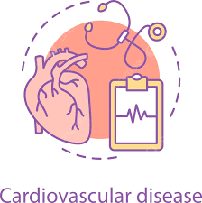
Why is it important?
Cardiovascular diseases (CVDs) are the leading cause of death worldwide (~31% of global mortality).
Early detection is crucial for reducing fatalities.
Traditional methods are time-consuming and expertise-dependent.
Notes:
Cardiovascular diseases (CVDs) are the leading cause of death worldwide. Early detection and management are critical to reducing CVD-related fatalities. By leveraging big data processing and predictive analytics, healthcare providers can develop a machine-learning-based model to assess a patient's risk of heart disease in real time. This presentation explores how machine learning and big data analytics can improve the early detection of cardiovascular diseases by accurately predicting individuals at high risk based on key health indicators.

Slide 3

Research questions
How can machine learning improve early CVD detection?
How does age influence CVD risk across gender?
Do chest pain and exercise-induced angina increase risk?
What role does resting ECG play in risk identification?
What patterns exist between old peak depression and heart disease occurrence?

Slide 4
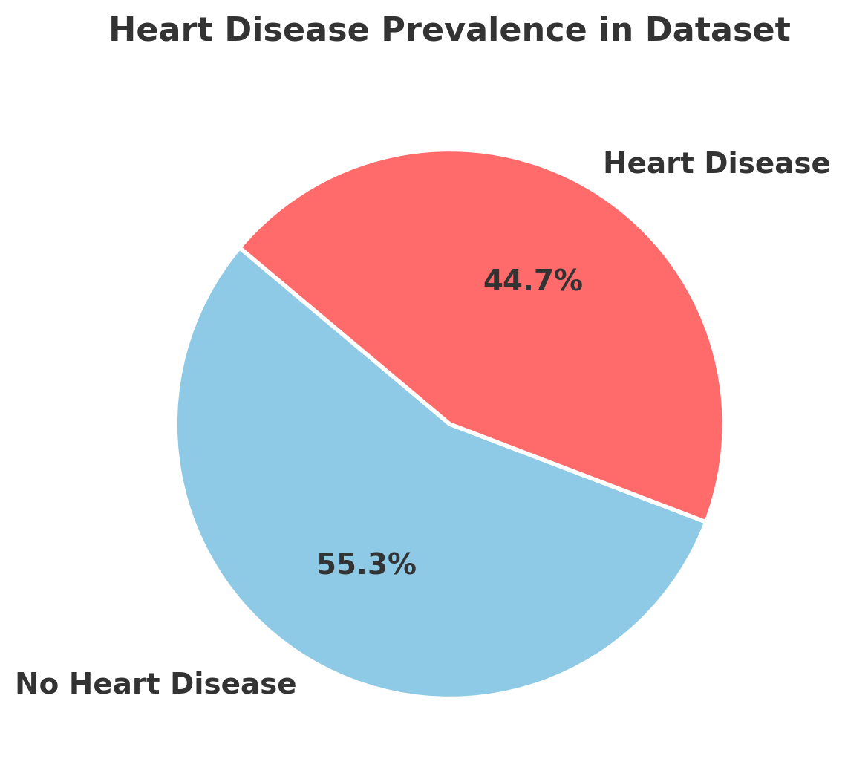
Dataset Description
11 key health features used for heart disease prediction.
Includes Age, Sex, BP, Cholesterol, ECG, MaxHR, Chest Pain Type, Exercise Angina, Oldpeak, and ST Slope.
Target Variable: HeartDisease (0 = No, 1 = Yes).
No missing values, categorical encoding applied.
Dataset link: https://www.kaggle.com/datasets/fedesoriano/heart-failure-prediction/data

Slide 5
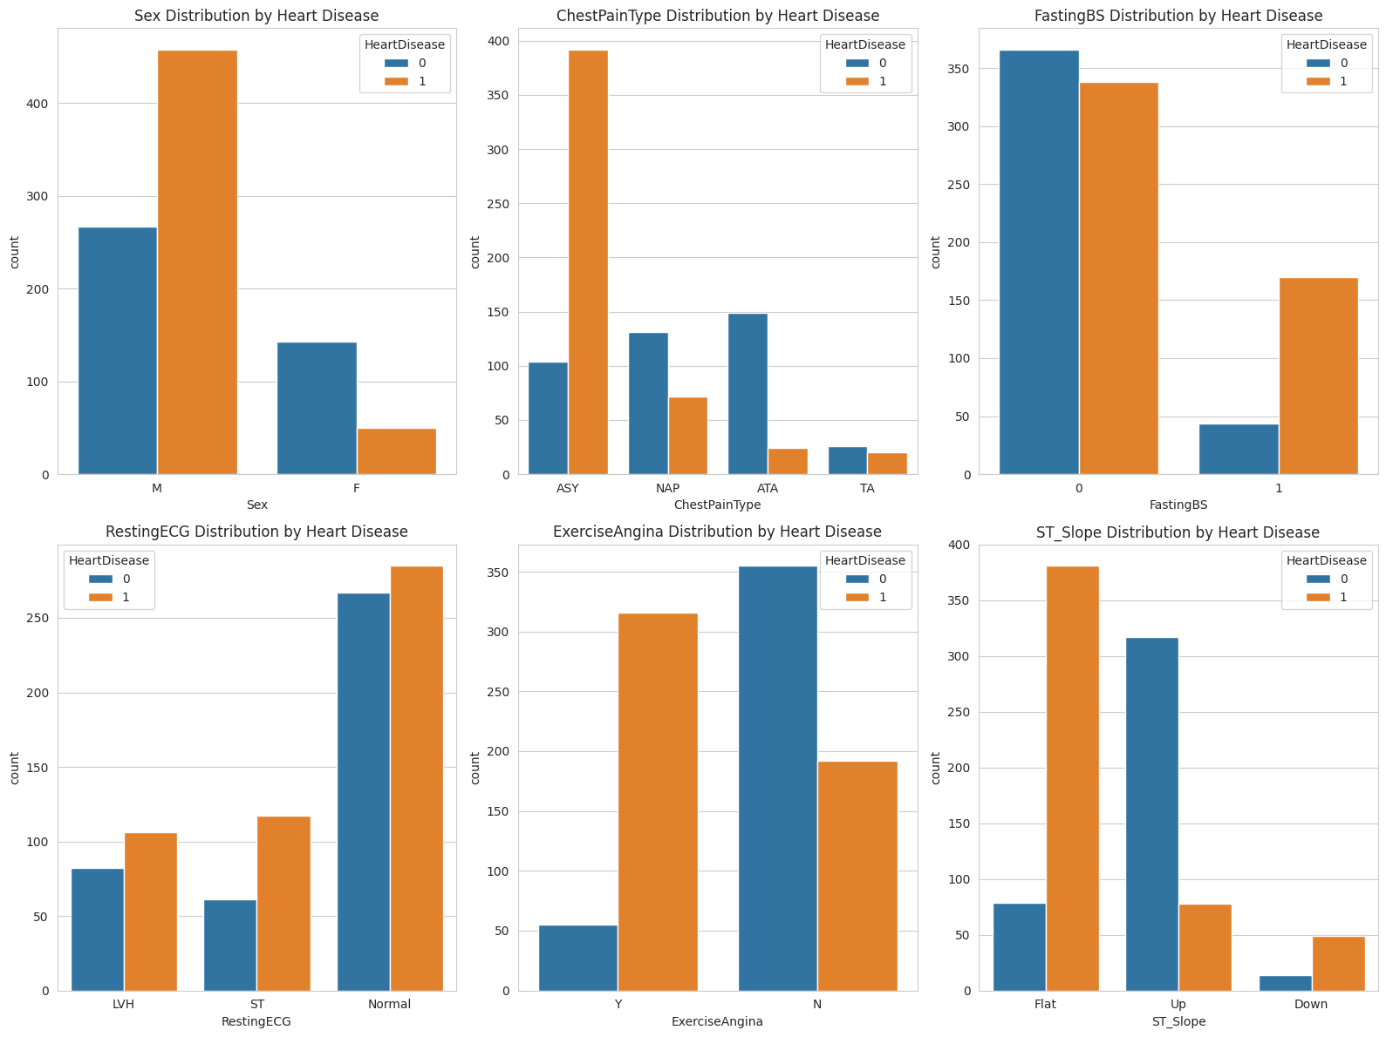
Data Preprocessing and Unique Values
Data Ingestion
Unique Values
Summary Statistics
The dataset contains 8 rows with no missing values, ensuring data integrity.
Parameters such as age, sex, chest pain type, and resting blood pressure have varying unique values.
Feature | Minimum | Maximum | Average | Standard Deviation
Age | 28 | 77 | 53.51 | 9.432
bp | 0 | 200 | 132.4 | 18.51
chol | 0 | 603 | 198.8 | 109.4
hr | 60 | 202 | 136.81 | 25.5
oldpeak | -2.6 | 6.2 | 0.88 | 1.1
 | age | sex | chest_pain_type | resting_bp | cholesterol | fasting_bs | resting_ecg | max_hr | exercise_angina | oldpeak | st_slope | heart_disease
Unique Values | 50 | 2 | 4 | 67 | 222 | 2 | 3 | 119 | 2 | 53 | 3 | 2
Missing Values | 0 | 0 | 0 | 0 | 0 | 0 | 0 | 0 | 0 | 0 | 0 | 0
Categorical Encoding
Categorical encoding techniques like one-hot encoding were applied for data transformation.
The dataset belongs to the Healthcare domain. It helps us predict heart failure based on the patients other measurable medical parameters. There are no missing values in the dataset and we dropped the duplicate rows if present.

Slide 6
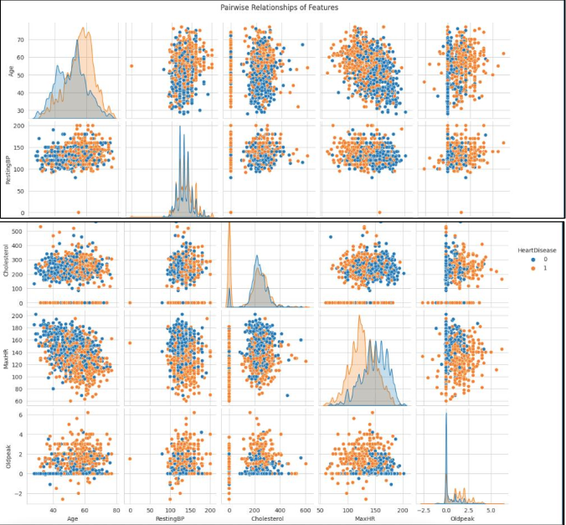
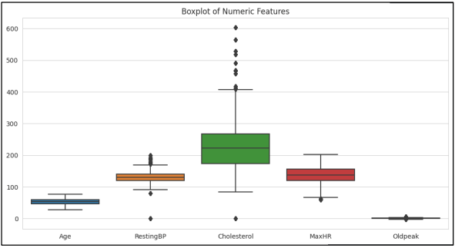
Visualizations and Insights from Boxplots
1
Age Distribution
2
RestingBP Distribution
Relatively narrow distribution between 30-80 years, with a median around 55 years and few outliers.
Ranges primarily between 100-175 mmHg, with a median around 130 mmHg and some lower outliers.
3
Cholesterol Distribution
Widest distribution of all features, ranging primarily between 100-275 mg/dL, with multiple high outliers.
Key observations from the boxplot: The patients range from 28 to 77 years old. Average age is about 53.5 years. Standard deviation of 9.43 years indicates moderate variation in age.

Slide 7
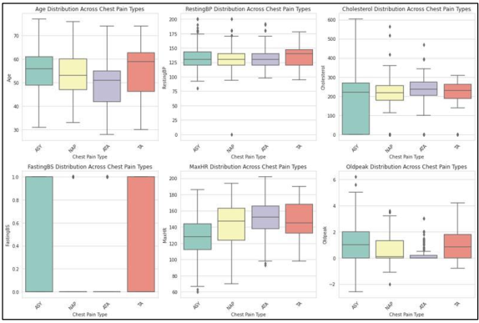
Relationships Between Categorical and Numerical Features
Key Takeaways from Each Plot:
All CP types show a similar median age (~50–60 years).
Outliers exist for younger patients (~30s). TA (Typical Angina) has a slightly higher median age compared to others.
Notes:
All chest pain types show a similar median age (~50–60 years). Outliers exist for younger patients (~30s).
Median RestingBP is similar across groups (~120-140 mmHg). ASY shows higher outliers, indicating some patients with extremely high BP.
ASY has a wide spread, with some extreme outliers (~500-600 mg/dL). Other CP types have a lower spread but similar median cholesterol levels.

Slide 8
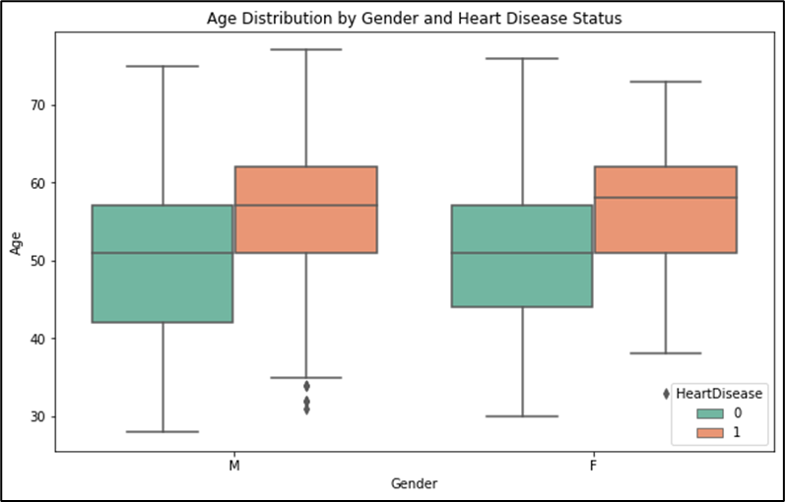
Q1. How does age influence the likelihood of developing heart disease across different gender groups?
Age Metrics
Patients range from 28 to 77 years old, with an average age of 53.5 years. Moderate variation in age is indicated by a standard deviation of 9.43 years.
Inference
Age increases the likelihood of developing a heart disease increases

Slide 9
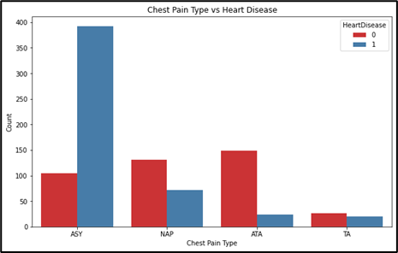
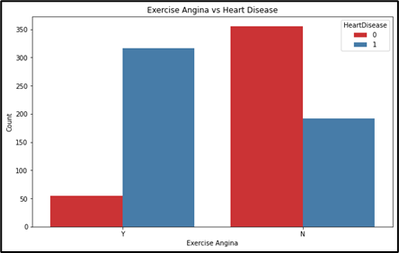
Q2. Does the presence of chest pain and exercise-induced angina increase the risk of heart disease, and how do these factors interact with other variables?
Inference
In case of ASY type of chest pain there is an extremely high chance of developing heart disease. Similarly, if there is pain in angina after exercising then there is a high chance of having heart disease.

Slide 10
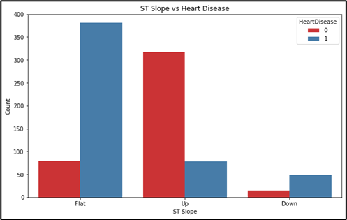
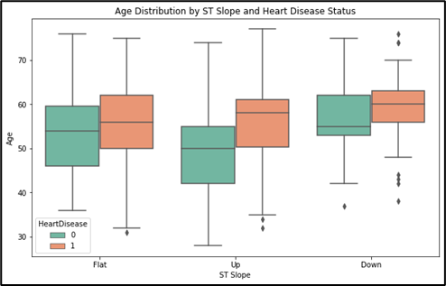
Q3. Is there a significant difference in heart disease prevalence among individuals with varying ST slope levels, and how does it compare across different age groups?
Inference
A large number of individuals with a flat and downward ST slope have heart disease. The majority of individuals with an upward-sloping ST segment do not have heart disease. For each ST slope category, the age distribution of individuals with heart disease tends to be slightly higher than those without heart disease.

Slide 11
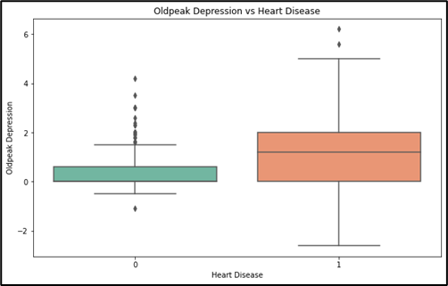
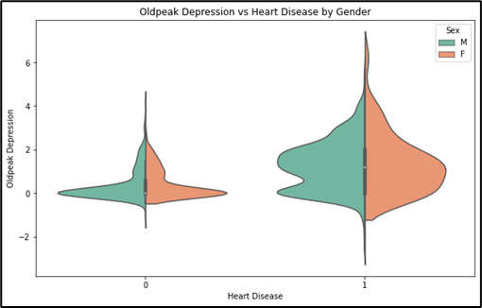
Q4. What patterns exist between old peak depression (from exercise) and heart disease occurrence, and do these patterns differ based on other clinical features?
Inference
A large number of individuals with a flat and downward ST slope have heart disease. The majority of individuals with an upward-sloping ST segment do not have heart disease. For each ST slope category, the age distribution of individuals with heart disease tends to be slightly higher than those without heart disease.

Slide 12




Key Health Indicators for CVD Prediction
Age
Chest Pain Type
Resting Blood Pressure
A major risk factor for heart disease, influencing the likelihood of developing CVD.
Categorizes chest pain experienced, indicating different levels of heart disease risk (TA, ATA, NAP, ASY).
Measures resting blood pressure; high values indicate hypertension, a major CVD risk factor.

Slide 13
Predictive Modeling with Random Forest
Random Forest Model
Hyperparameter Tuning
Model Evaluation
The model was trained on the Spark MLlib framework, which efficiently processes large datasets using distributed computing.
We used Area Under the Curve (AUC) to evaluate classification performance.
Cross-validation was applied to optimize hyperparameters such as learning rate and number of trees.
Specifically, a grid search with 5-fold cross-validation was performed to find the optimal combination of hyperparameters that maximized the model's performance on a validation set.
Key hyperparameters tuned included the number of trees in the forest (n_estimators), maximum depth of the trees (max_depth), and the minimum number of samples required to split an internal node (min_samples_split).
The AUC score was 0.98, which signifies the model's excellent ability to distinguish between patients with and without heart disease.
The high accuracy and AUC score indicate that the Random Forest model is a promising tool for predicting heart disease.
The ROC AUC score was also calculated, providing a measure of the model's ability to discriminate between positive and negative cases.

Slide 14
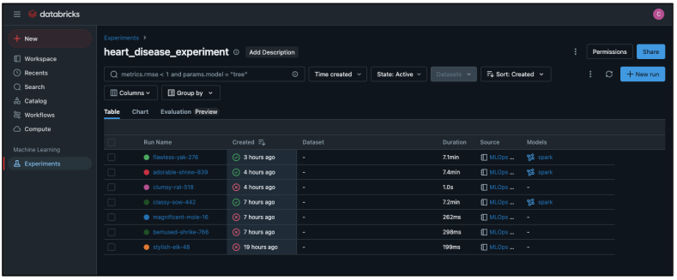
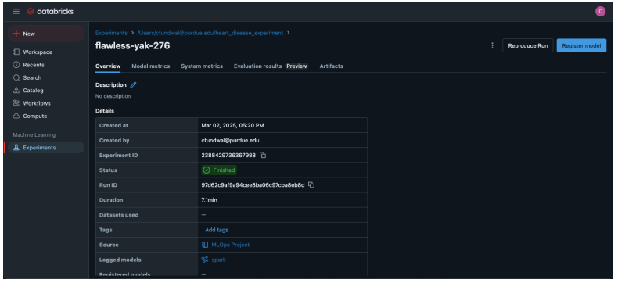
Automation and Experiment Tracking
Experiment Tracking
Model Metrics
Automation and experiment tracking were implemented to monitor and manage the model's performance over time.
Metrics such as RMSE and model parameters were tracked to ensure optimal performance.
Evaluation Results
Evaluation results were visualized through tables and charts to assess the model's effectiveness.
The model successfully identified key predictors of cardiovascular disease, aiding in risk assessment. Healthcare providers can use this model to prioritize high-risk patients for early intervention.

Slide 15

Strategic Implications for Healthcare
1
Stronger Screening
Develop stronger screening protocols for asymptomatic patients, particularly males.
2
Multi-Marker Assessment
Emphasize multi-marker assessment approach rather than relying on single indicators like ECG or symptoms.
3
Lower Thresholds
Consider lower thresholds for stress testing in high-risk demographic groups.
4
Heart Rate
Incorporate maximum heart rate as a potential early warning indicator alongside traditional risk factors.
Patient Demographics and Symptom Patterns: Significant gender imbalance: Males (65-70%) dominate the patient population, suggesting targeted screening programs for men may yield higher detection rates.

Slide 16




Insights & Business Recommendations
Insurance Companies
Implement dynamic, risk-based premium models using predictive heart disease risk factors.
Wearable Tech & AI Diagnostics
Enhance ECG monitoring tools with ST slope and Oldpeak depression analysis.
Public Health Initiatives
Focus awareness campaigns on older adults and high-risk groups to promote early prevention.
Notes:
Model performance visualization showcases how well predictions align with actual outcomes, validating its effectiveness in real-world applications. Future improvements could integrate additional clinical variables and leverage advanced deep-learning techniques for enhanced accuracy.

